Slide 1
Splunk Dashboards and Visualizations
Cybersecurity
Lesson 19.1

Slide 2

Learning Objectives
By the end of today’s class, you will be able to:
1
Create visualizations of single- and multiple-value searches.
2
Use the geostats and iplocation commands to add location-based visualizations to searches.
3
Combine multiple visualizations in a single dashboard.
4
Modify dashboards with time range input and drilldown capabilities.

Slide 4
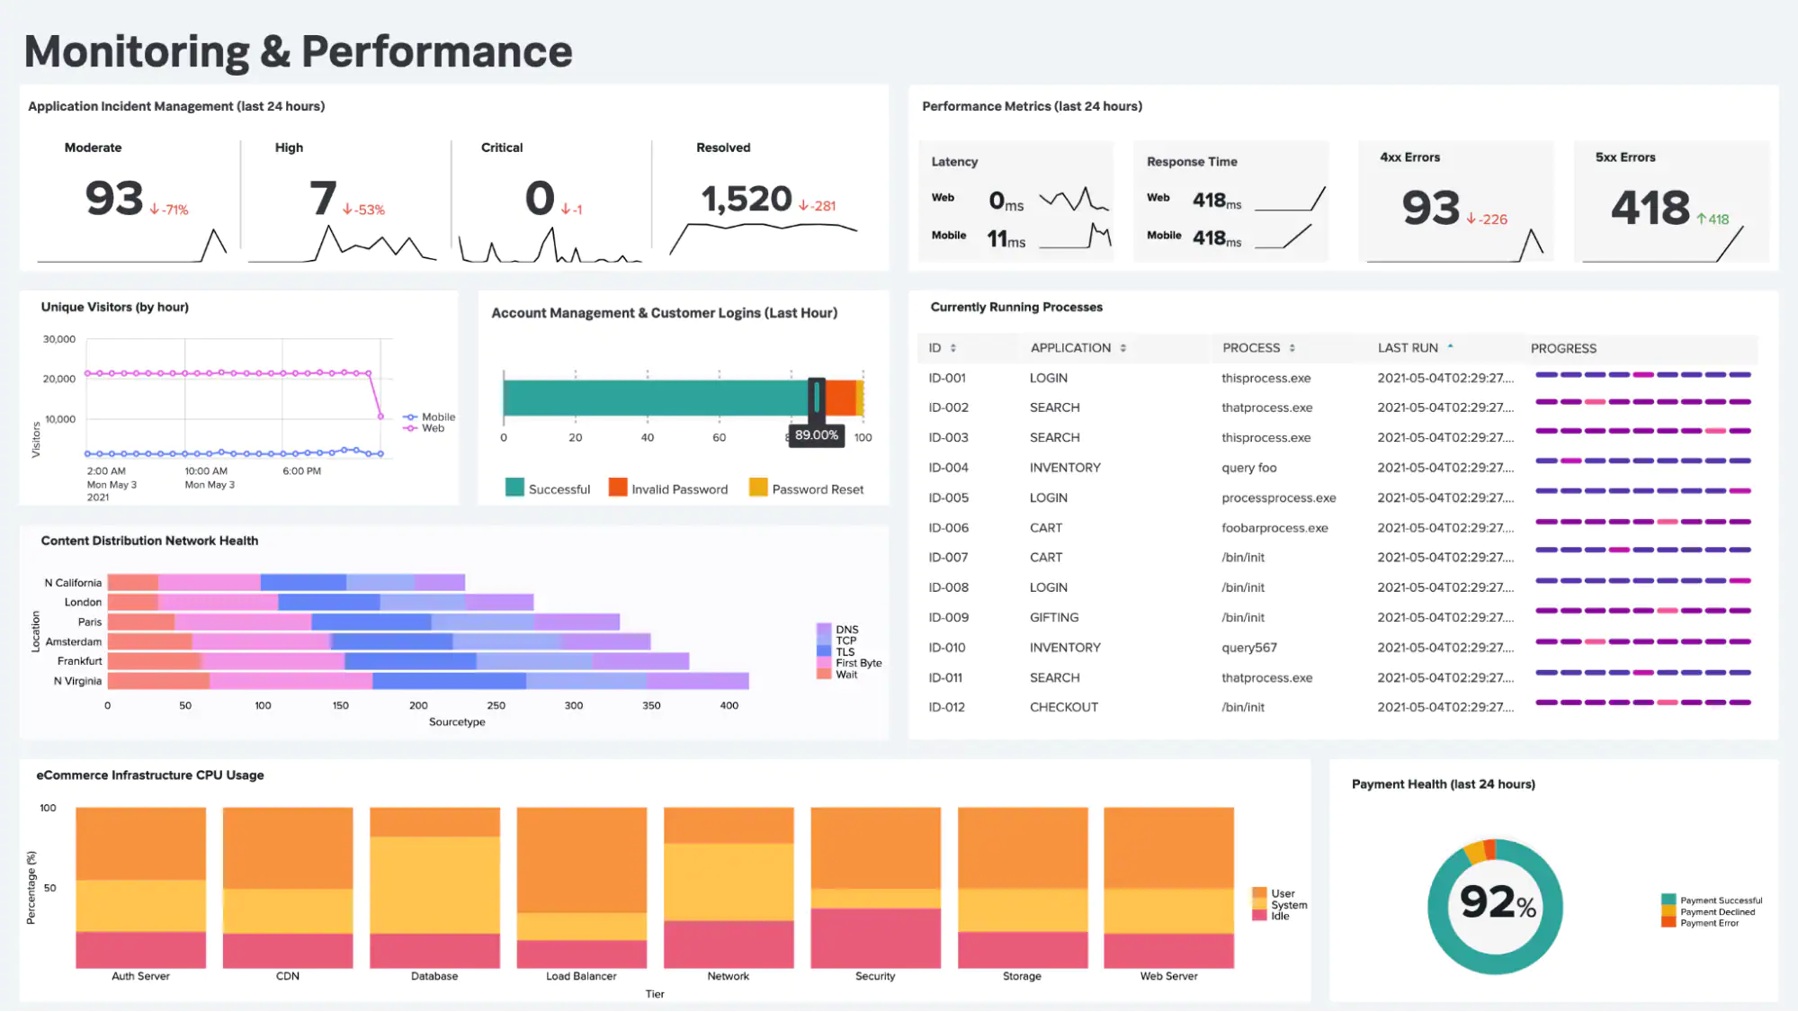
Today, we’ll learn how security professionals use Splunk’s visualization capabilities to identify and mitigate security issues.
https://www.splunk.com

Slide 6
Let’s first review the last class:
1
Splunk uses the Statistics feature to display specific values from search results in an easy-to-read spreadsheet.
2
The eval command is used to design new fields or modify existing fields.
3
Splunk uses reports to save searches and run them at designated times.
4
Splunk alerts are designed to send automatic notifications when a specific condition, known as a trigger condition, is met.

Slide 7

Designing poor alerts can cause two types of issues:
False positives occur when conditions are met and an alert is triggered, but the security situation being monitored did not actually occur.
False negatives occur when the condition is met and an alert is not triggered, meaning the security situation occurred undetected.

Slide 8
Baselining is a method of looking at historical data to determine how much activity is considered "normal."

Slide 9

Recap: Baselining
Security professionals use baselining to determine a threshold: The condition or level that, when met, triggers an alert.
Setting the threshold too high
risks missing an alert.
Setting the threshold too low
creates too many false positives.

Slide 10

Security professionals
may encounter the challenge of alert fatigue.
This occurs when they receive
too many alerts to adequately respond to each one.
Notes:
shutterstock_1229109085

Slide 11
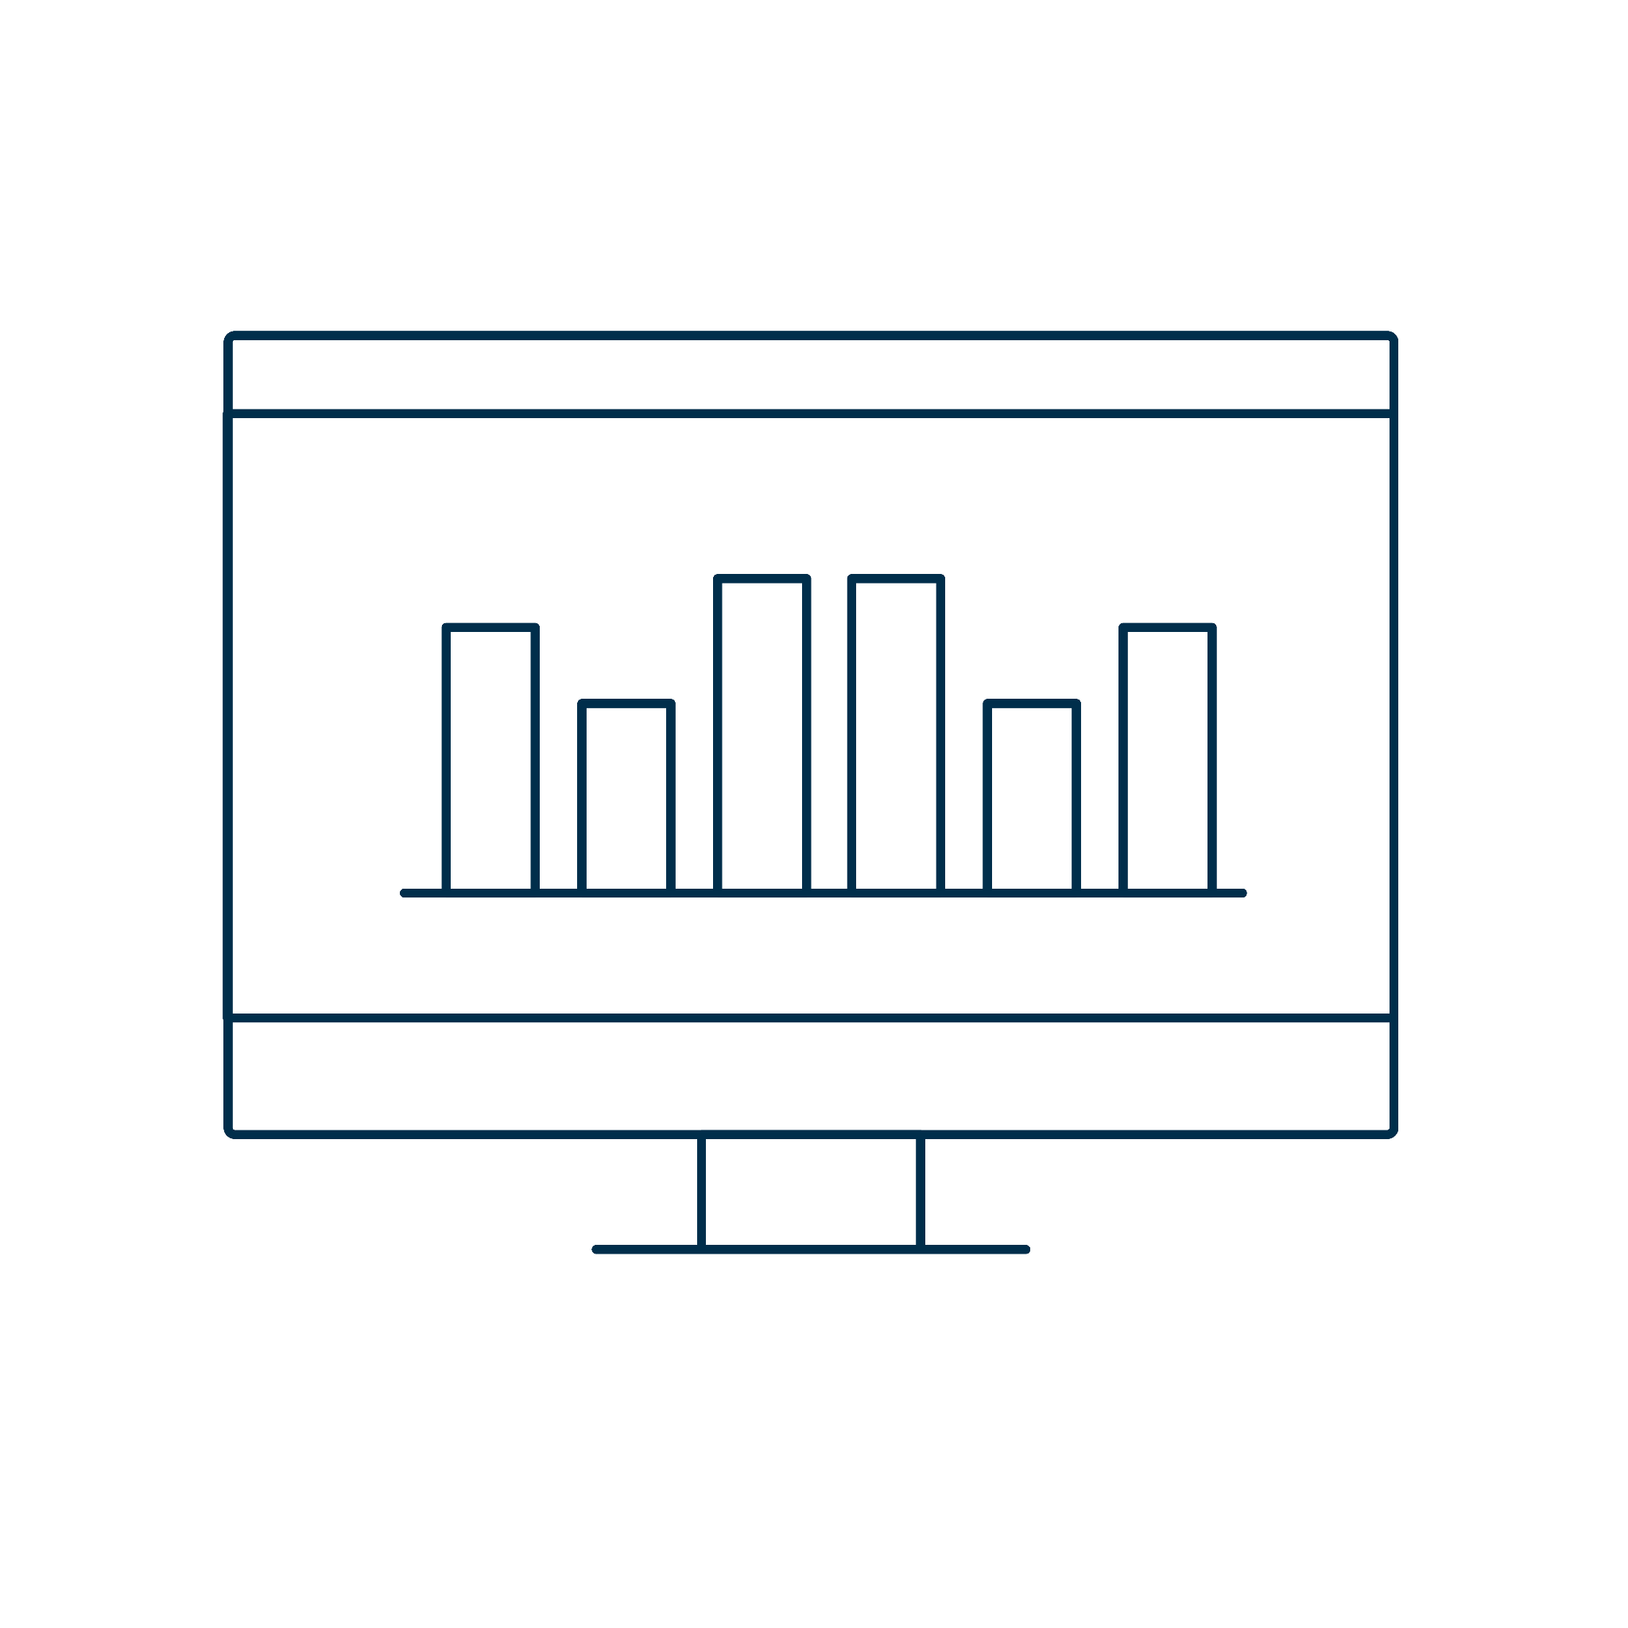
Introduction to Visualizations

Slide 12
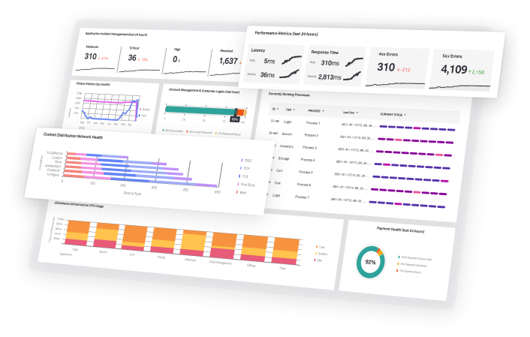
Introduction to Visualizations
Today, we’ll use Splunk to create contextualized and informative visuals.
We’ll use these to analyze and research system and security issues.
https://www.splunk.com/

Slide 13
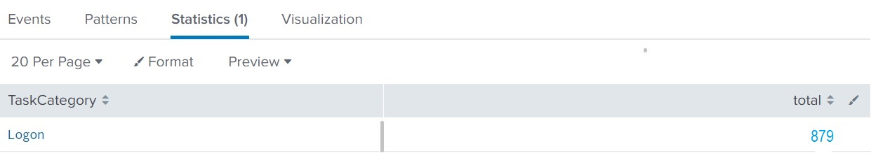
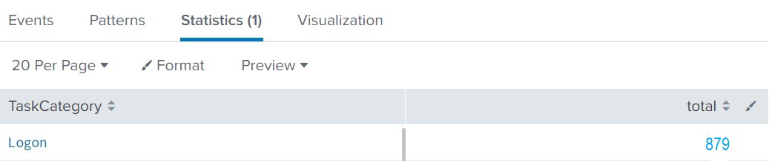
Contextualizing Data
Example: Table showing the number of logins to a web application per minute
Number of logins per minute

Slide 14
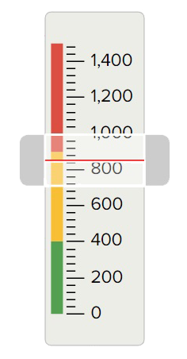
Contextualizing Data
The gauge visualization contextualizes the number 879 by highlighting the severity of the login count.

Slide 15
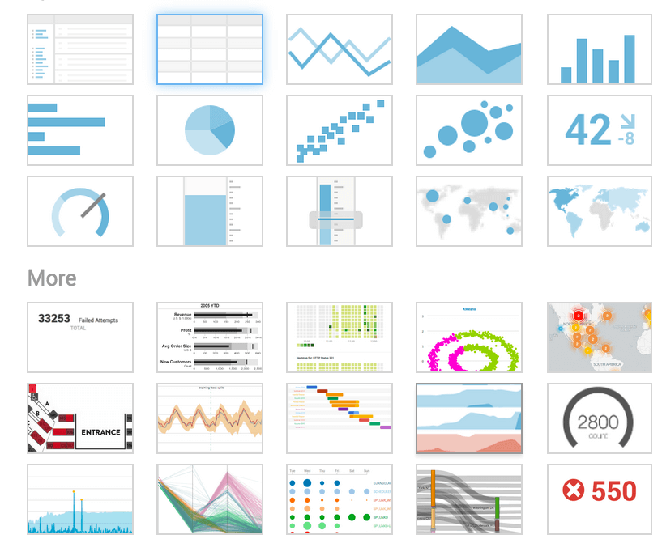
Splunk uses visualizations to make complex data
easier to understand and analyze.
(Source)

Slide 16

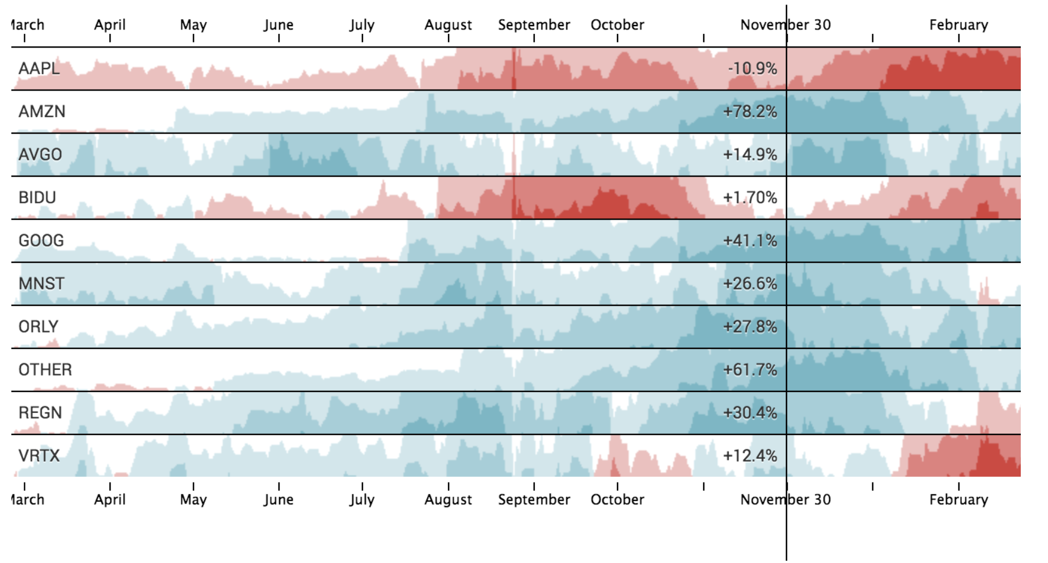
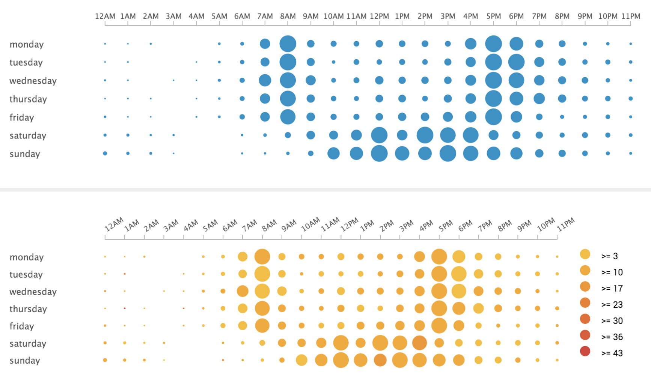
Splunk Visualizations
Splunk visualizations allow interactivity and offer more in-depth details.
These visualizations range from simple bar and column charts to more complex horizon charts and punch cards.
Horizon chart
Punch card
(Horizon Chart)
(Punchcard)

Slide 17
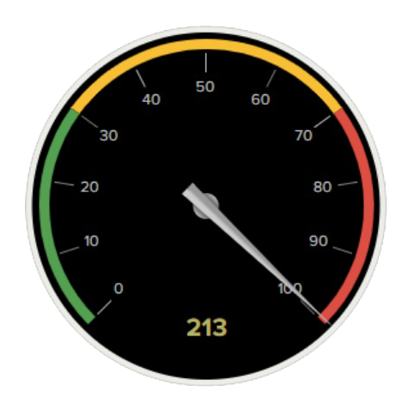
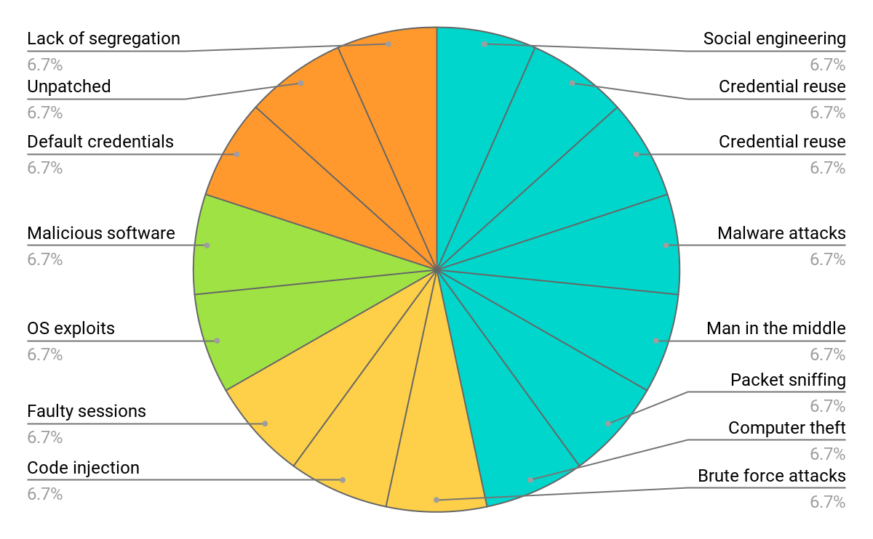
Splunk Visualizations
Splunk visualizations can display single values, such as total attacks, or multiple values, such as attacks correlated by attack type.
Single-value visualizations
Multiple-value visualizations
Database attacks
Server attacks
Web attacks
User attacks

Slide 18
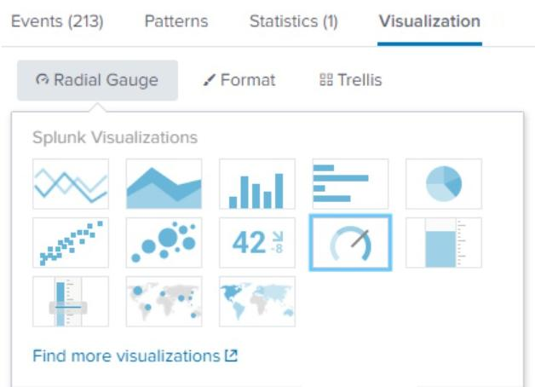
Single-Value Visualizations
In the first demonstration, we’ll use a single
value to create a radial gauge visualization.
Radial gauges are similar
to the RPM dial in a car dashboard.
RPM (revolutions per minute) is a single value visualized in the dial.
The dial includes a red section that indicates when the level is too high.

Slide 19
Single-Value Visualization

Slide 20

Single-Value Visualizations
This week, you will continue to play your role as SOC manager at OMP.
The networking team notified you that OMP’s public-facing website experienced performance issues over the weekend.
You are tasked with designing a single-value radial gauge to help monitor attacks against OMP's website.
15 Minutes

Slide 23

Multiple-Value Visualizations

Slide 24
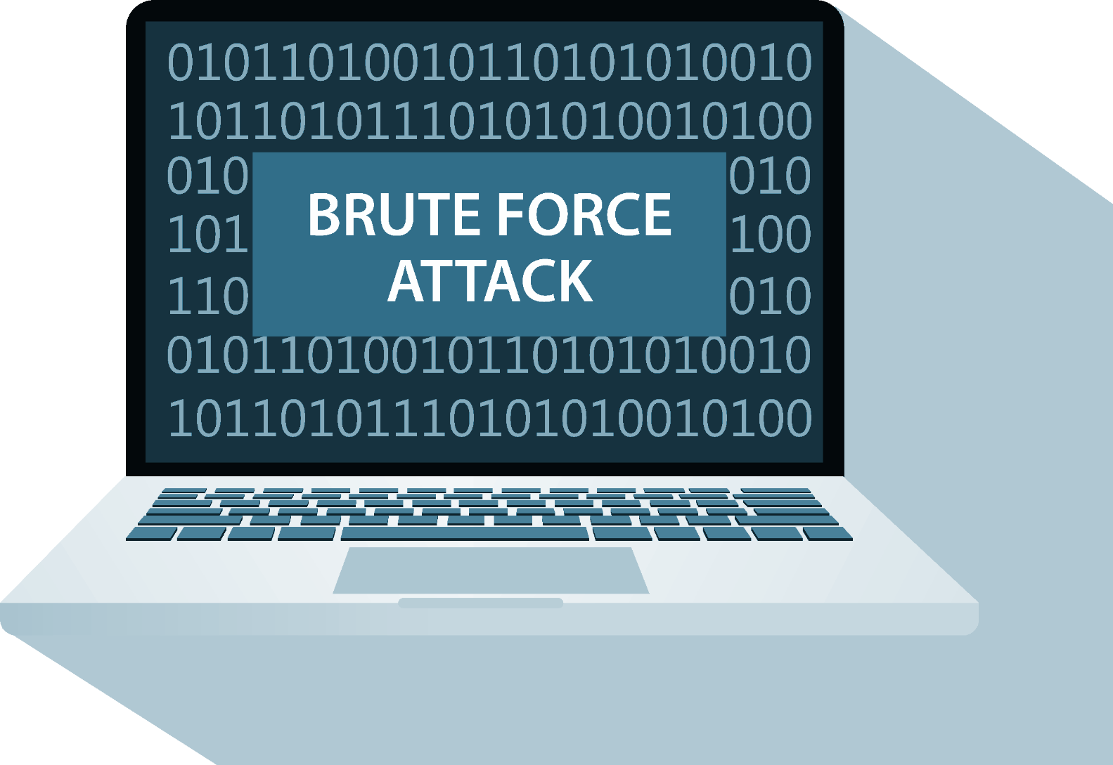
Multiple-Value Visualizations
Suppose a business
is experiencing brute-force attacks against a web application.
The SOC manager wants to visualize the list of users being attacked and the number of attacks experienced by each user.
Notes:
shutterstock_599075294_attack

Slide 25
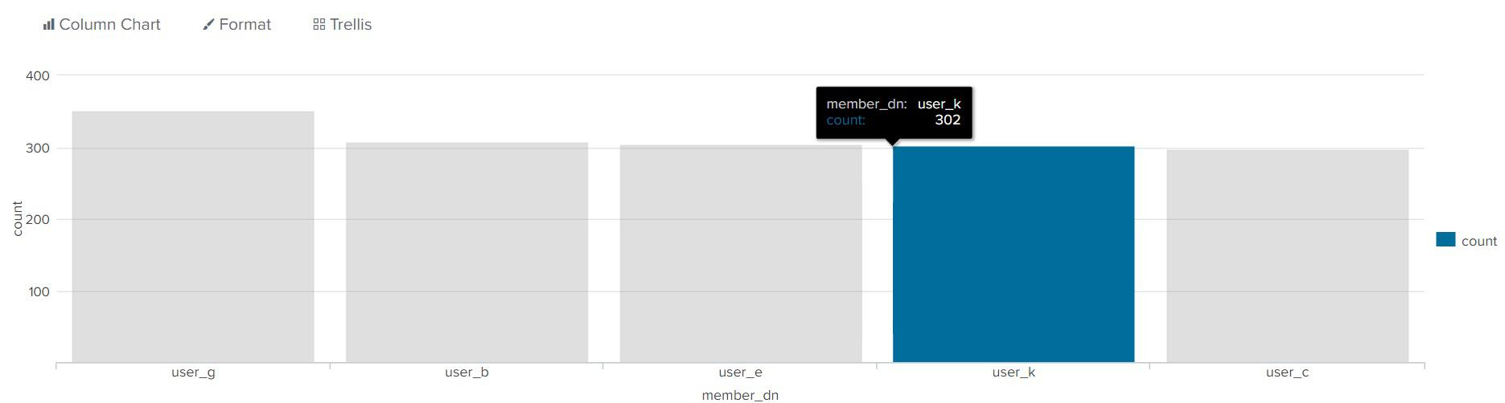
Multiple-Value Visualizations
We can convert Splunk stat spreadsheets into more informative and interactive visualizations. The data found in the spreadsheet can be displayed in a column chart.
When hovering the mouse over
a user, the number of attacks experienced by this user is displayed.

Slide 26
Multiple-Value Visualizations

Slide 27
Multiple-Value Visualizations
Your SOC staff are impressed with the radial gauge you designed to monitor attacks against the web server.
They would like you to create a visualization of the exact URL paths targeted by attacks.
You are tasked with designing a multiple-value visualization to display the URL paths targeted by the POST requests.
15 Minutes

Slide 30


Geographic Map Visualizations

Slide 31
Organizations can monitor where users access the application from to help determine the source of security issues.

Slide 32
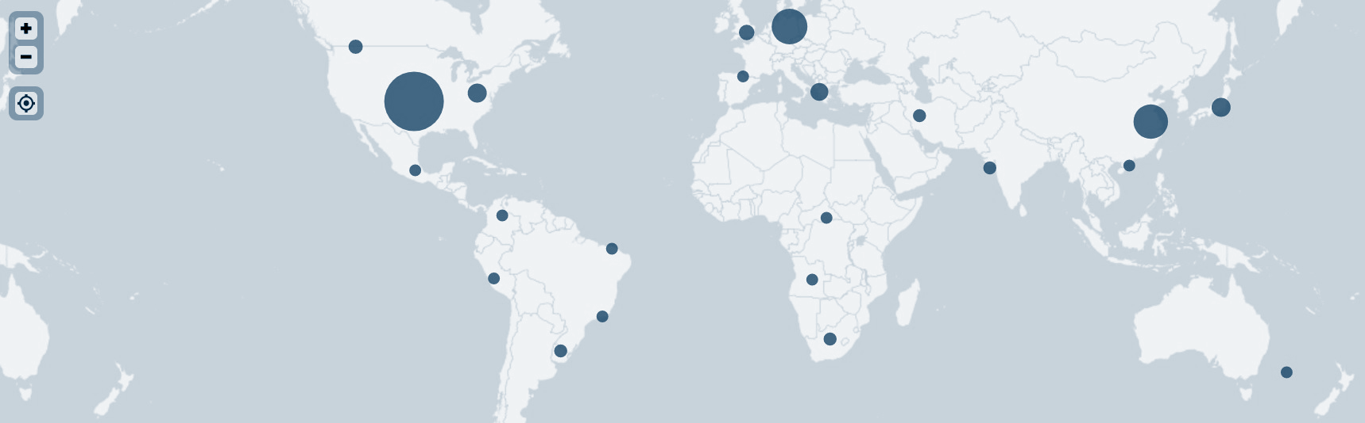
Geographic Map Visualization
Example:
A business knows that its application customers are primarily located in the United States. A significant number of users accessing the application from another country is a cue to investigate the activity.

Slide 33
Geographic Map Visualization
To create these maps and gain insight into the locations of activity, we’ll use the following commands:
The iplocation command outputs the city and country data of an IP field, such as src_ip or dest_ip.
sourcetype="stream:http" | iplocation src_ip
The geostats command uses the location data found with the iplocation command to map latitude and longitude data for each event.
sourcetype="stream:http" | iplocation src_ip | geostats count

Slide 34
Geographic Map Visualization

Slide 35
Geographic Map Visualization
OMP would like you to expand your visualizations to provide more geographic information on the attacks.
The security team can use this information to create firewall rules that restrict traffic from specific geographic locations.
You are tasked with designing a geographic map visualization to help your SOC team understand where attacks originated.
15 Minutes

Slide 39

Splunk Dashboards

Slide 40
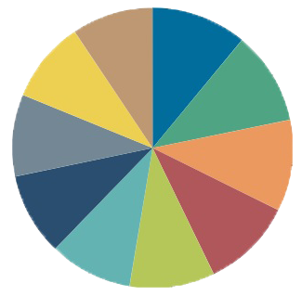
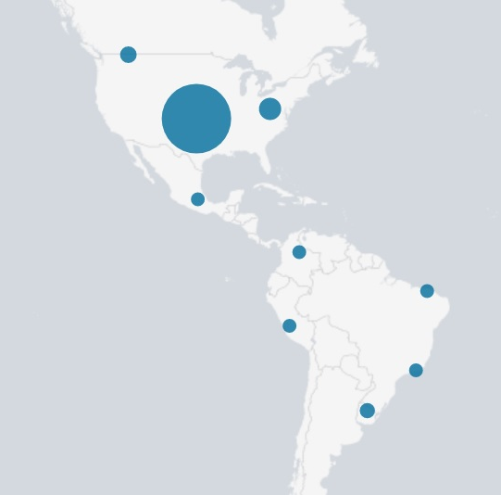
Splunk Dashboards
So far, we’ve covered the following visualizations:
Single value
Multiple values
Geographic maps

Slide 41
Splunk Dashboards
While each of these visualizations is useful on its own, they are even more effective when grouped and displayed together.
Single value
Multiple values
Geographic maps

Slide 42
Splunk Dashboards
An organization that is monitoring a website may want to view all of the following simultaneously:
The volume of successful logins on the website
The volume of unsuccessful logins on the website
A geographic map illustrating where the activity is coming from
A pie chart displaying the specific pages of the website that are being accessed

Slide 43
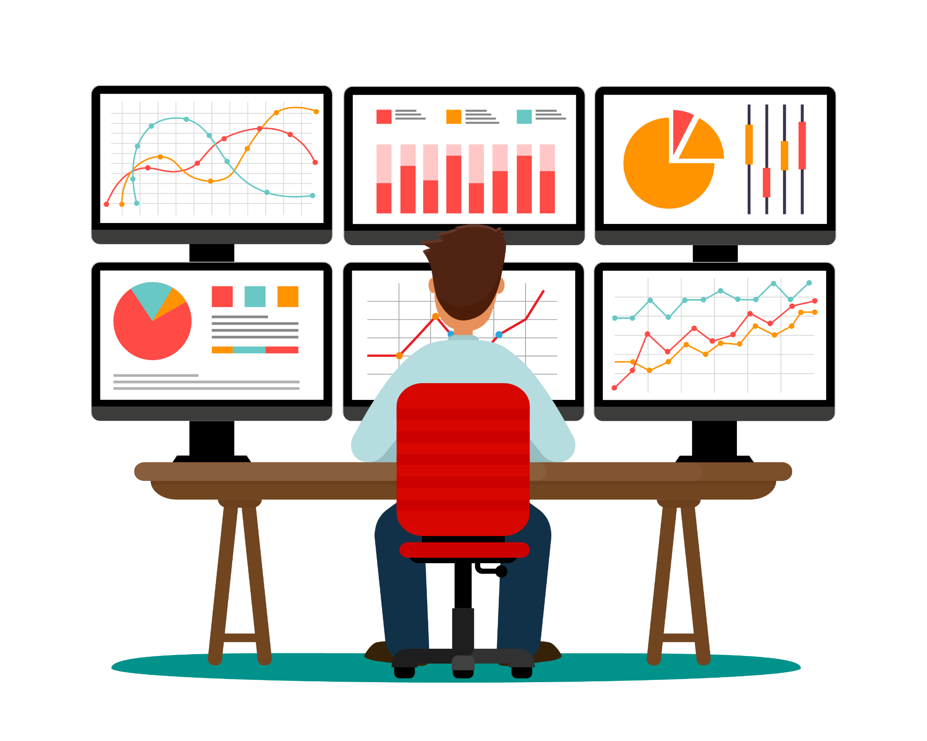
Displaying all this information together can provide a security analyst with
a complete picture of the state of their web application.
Notes:
shutterstock_1069439285

Slide 44
Dashboards are a collection of multiple visualizations in a single location.

Slide 45
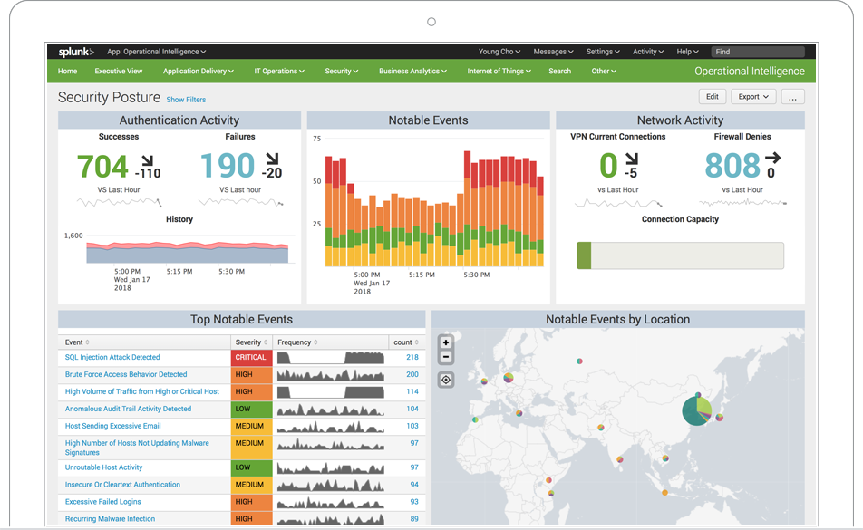
Dashboards
The visualizations are placed in different sections, called panels.
Panels can contain:
Single-value visualizations
Multiple-value visualizations
Geographic maps
Statistical charts
(Splunk.com)

Slide 46
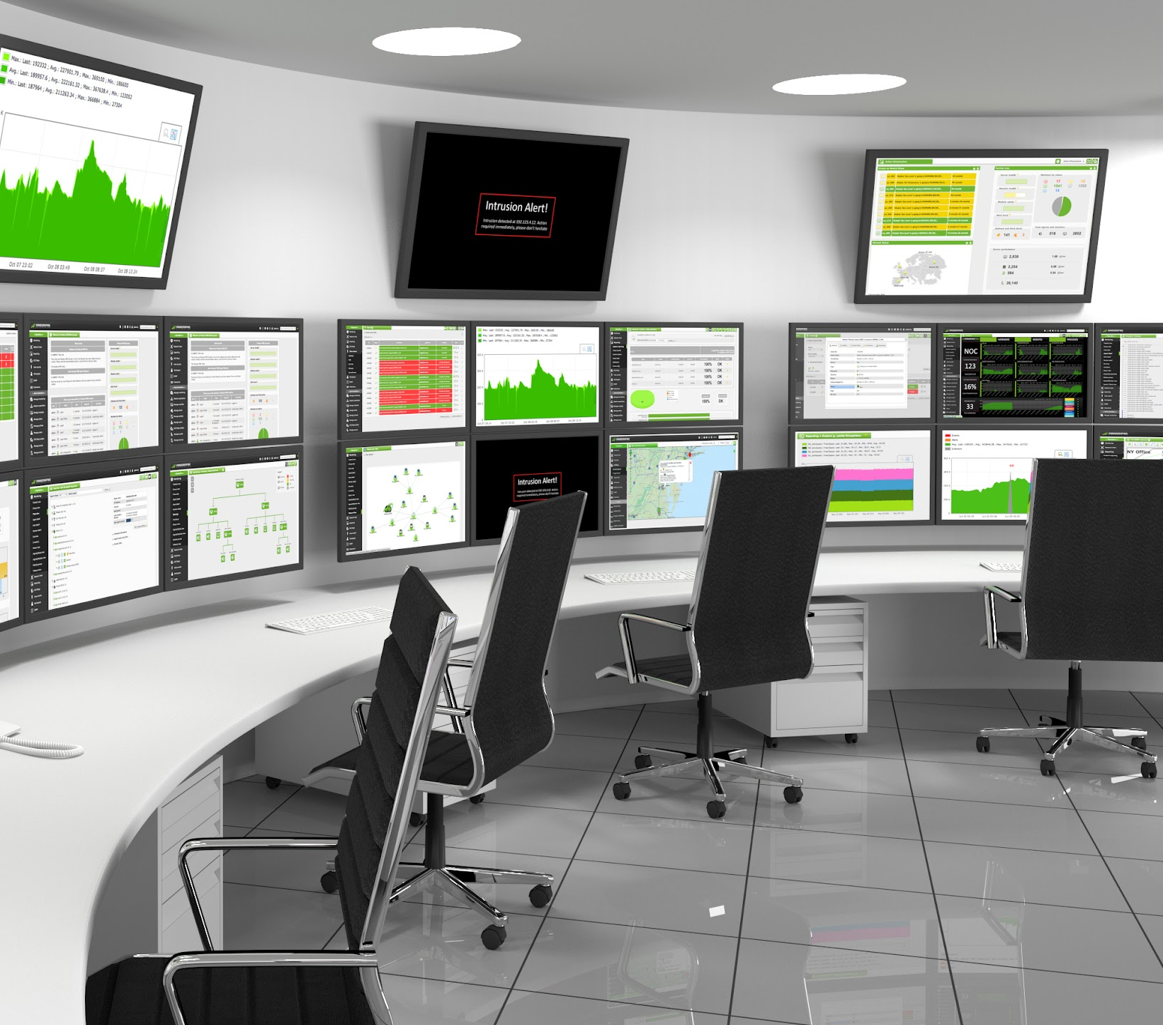
SOCs often have dashboards displayed on multiple screens
in the operations room to provide availability and functionality across staff.
Notes:
shutterstock_294087938

Slide 47
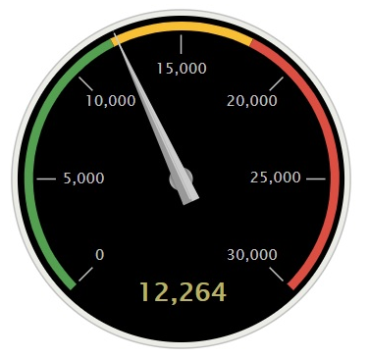
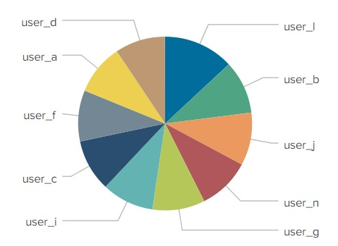
Dashboard Demo Scenario
As SOC manager, you would like to create a single three-panel dashboard
to monitor your Windows server. You want the panels to include:
Windows Monitoring Dashboard
Windows Login Count
Top 10 Windows Users
A radial gauge of successful logins
A pie chart of users logging in
Windows Users Login
A statistical chart of the data
in the pie chart
user
count
user_1
936
user
710

Slide 48
Creating Dashboards

Slide 49
Creating Dashboards
Next, your team would like to view all of these data visualizations in a single location.
You are tasked with designing a single dashboard to view all of the visualizations in a single location.
15 Minutes

Slide 52
Drilldowns and Dashboard
Interactivity

Slide 53


Drilldowns and Dashboard Interactivity
Similar to many other applications in Splunk, dashboards have advanced features that can help information security professionals research security issues.
These include:
We will learn how to configure these features by using the dashboard and scenario from the
last demonstration.
Direct input modifications within dashboards
Drilldowns
within panels for further analysis

Slide 54
Drilldowns and Dashboard Interactivity
As SOC manager, you created a three-panel dashboard to monitor your Windows server.
Windows Monitoring Dashboard
You will expand the functionality of this dashboard by:
Modifying the date and time ranges being analyzed directly on the dashboard
Adding a drilldown into the visualizations to assist with further analysis
Windows Login Count
Top 10 Windows Users
Windows Users Login
user
count
user_1
936
user
710

Slide 55
Drilldowns and Dashboard Interactivity

Slide 56
Advanced Dashboards
Your SOC staff appreciate the great work you did to build a robust dashboard to monitor attacks against the web server.
Several people have requested that you make the dashboard panels more interactive so they can quickly research attacks.
You are tasked with enhancing your dashboard to add drilldowns and interactivity features.
15 Minutes

Slide 59
Advanced Security Monitoring Tools

